Slide 1
Selected Aspects of Automation project on, Electronic Safe
Presented by: [Group 8]
Sneha Potadar
Manzoor Ambekar
Guided By:
Prof. Dr.-Ing. habil. Olaf Simanski,
Dipl. -Ing. Uwe Starke
8th March 2023
Department of Information and Electrical Engineering

Slide 2
Motivation
Increased security (SOS signal and alarm for theft and disaster)
Remote monitoring
Audit trails
Monitors the environmental conditions
Improvements is easy to implement
Easy of use

Slide 3
Overview
The Secure Electronic Safe is a technologically advanced solution for safekeeping valuables.
Integrating Arduino, Raspberry Pi, IFTTT, and various sensors such as DHT 11, motion, buzzer, keyboard, servomotor, and LED, it provides superior security, user-friendly operation, and comprehensive monitoring.
This project showcases the potential of modern technology to enhance traditional safekeeping methods.

Slide 4
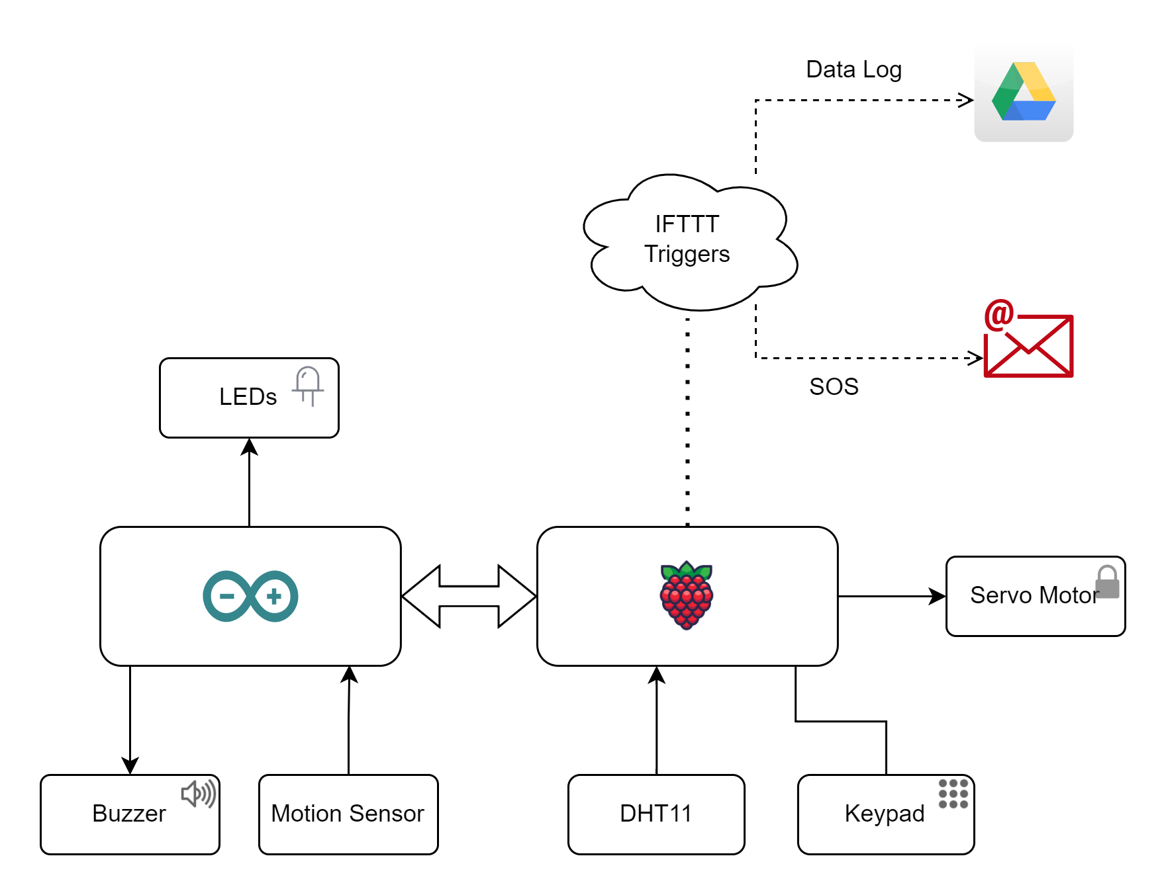
Block Diagram

Slide 5
Libraries Used
Adafruit_DHT - DHT11
Time - Time monitoring
Pyfirmata - Access to Arduino
chestnut.arduino - Flashing Firmata to Arduino
RPi.GPIO - Access to RP
Gpiozero - Servo
ifttt_webhook - IFTTT webhook triggers

Slide 6
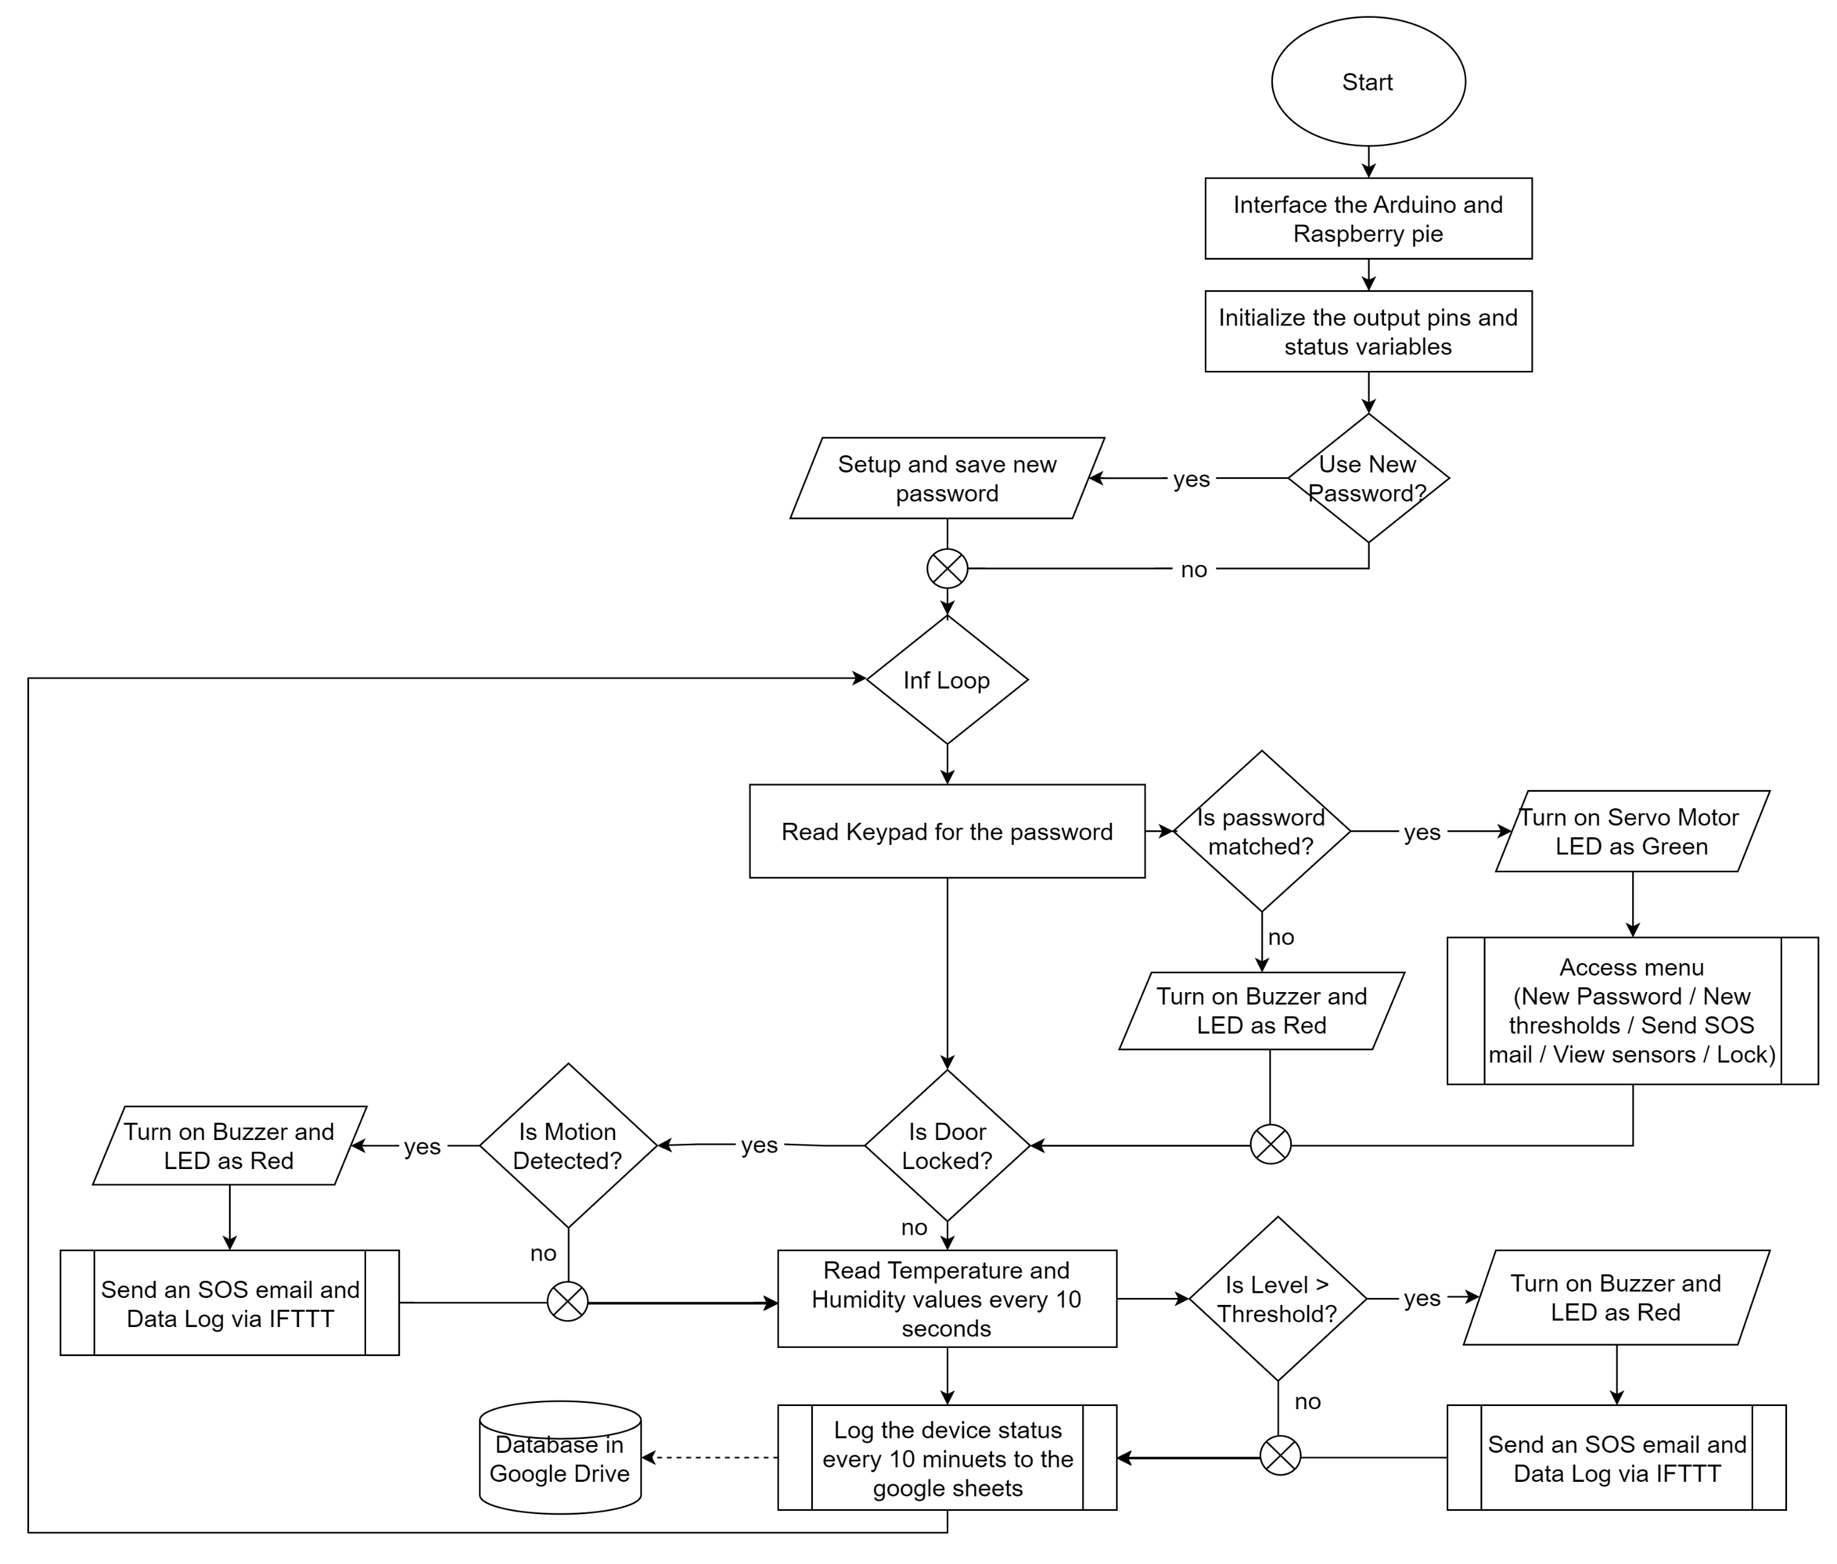
Flow chart

Slide 7
Future Scope
In the future iterations, following features can be implemented,
Advanced authentication (biometrics, Smart cards or Facial recognition)
Two factor authentication
Increased sensor coverage
Smart integration with home automation system
SMS Notifications
Energy efficiency
Improved locking system
Touch screen display for better user experience

Slide 8
Conclusion
The results of testing showed that the safe was able to effectively detect temperature changes and motion, secure the contents of the safe with a password-protected mechanism, and provide real-time notifications to the user.
In conclusion, the secure electronic safe project was a successful demonstration of the potential for utilizing advanced technologies in the development of secure storage solutions.
The project provides valuable insights into the potential for further developments in this field. And highlights the importance of considering the integration of various technologies in the design and implementation of security systems.

Slide 9
Thank you for your attention!
Any Questions?

